Slide 1
A Brief Introduction to Some
Collaborative RE Systems
Yi Li
2010.03.24

Slide 2
Agenda
An Overview of the Co-RE Systems
Introduction to Each System

Slide 3
An Overview of the Systems
System Name and Year | Mainly Targeted RE Phase | Core Techniques for Supporting Collaboration | Conflict Handling | Automation Support
gIBIS (‘88) | Elicitation | Specialized | Structured discussion | None
WinWin (’94 - 01) | Elicitation | Specialized | Structured resolution | None
Synoptic (‘91) | Elicitation, Analysis | Specialized | Structured resolution | Select possible resolution of conflicts
OPCI (‘08) | Elicitation | General | Free discussion | Cluster related requirements
WikiRE (‘07) | Elicitation | General | Free discussion | Detect problems in requirements
EGRET (‘06) | Management | General + Specialized | Free discussion | Analyze results of collaboration
Web RM Tools (’01 -- ) | Management | General | Free discussion | None

Slide 4
gIBIS
Jeff Conklin, Michael L. Begeman
gIBIS: a hypertext tool for exploratory policy discussion
ACM Transactions on Information Systems 1988

Slide 5
Introduction
The IBIS (Issue Based Information System) method
  Developed by Horst Rittel (‘70)
  Successfully used in architectural design, city planning and planning at World Health Organization.
gIBIS = graphical IBIS

Slide 6
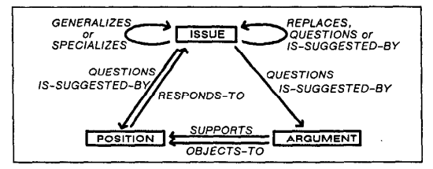
The IBIS Meta-Model

Slide 7
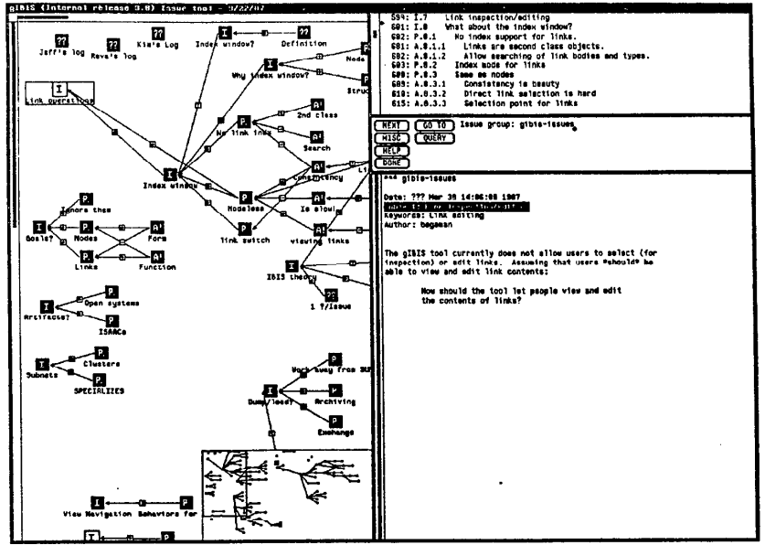
The gIBIS User Interface

Slide 8
Observations provided by the authors
Advantage
  Structured discussion helps emergence of implicit assumptions and definitions.
Disadvantage
  No support for goals and requirements, and several users have requested for these.
  No support for making a decision among the various positions of an issue, and there is no way to indicate that such a decision has been made.
  No support for unstructured material.
  Lack of prioritization.
  No effective support for “meta” discussions.

Slide 9
WinWin
http://csse.usc.edu/research/WINWIN/
Barry Boehm et al.
Software Requirements as Negotiated Win Conditions RE 94
Developing groupware for requirements negotiation: lessons learned IEEE Software 2001

Slide 10
Introduction
Used in requirements elicitation
Four generations of tool support
Case studies conducted in a software engineering course in USC. (At least 3 years, 60 – 80 students organized into 10 – 15 teams per year.)
Greatly inspired by the gIBIS tool

Slide 11
Review: observations from gIBIS
Observations from gIBIS | Correspondence in WinWin
Advantage
Structured discussion (Issue-Position-Argument) | A similar model for structured discussion. (Win Condition-Issue-Option-Agreement)
Disadvantage
No support for goals and requirements. | Specialized for requirements elicitation.
No explicit support for making a decision. | Making a decision by providing an agreement.
No support for unstructured material. | Adopt brainstorming to gather unstructured, raw information.
Lack of prioritization. | Allow prioritization of requirements.
No effective support for “meta” discussions. | (No improvement.)

Slide 12
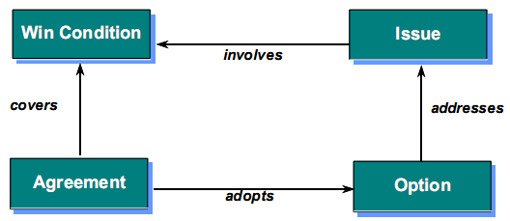
Key Concepts
Win Condition: objective which makes a stakeholder feel like a winner
Issue: conflict or constraint on a win condition
Option: A way of overcoming an issue
Agreement: mutual commitment to an option or win condition
Requirements

Slide 13
Steps of WinWin
Outlining topics (categorize requirements)
Brainstorm stakeholder interests
Converge on Win Conditions
Capture a glossary of Terms
Prioritize Win Conditions
Build the WinWin Tree (WIOA)
Organize negotiation results

Slide 14
Step 1: Outlining topics
How
  Stakeholders add comments recommending change to this outline
  A moderator reviews these comments with the group and modifies the outline

Slide 15
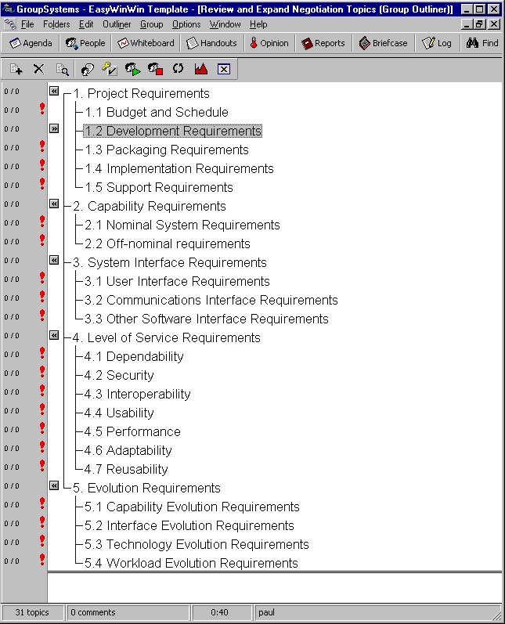

Slide 16
Step 2: Brainstorm stakeholder interests
Objective
  Share perspectives, views, background, expectations
How
  Anonymous
  Rapid brainstorming

Slide 17
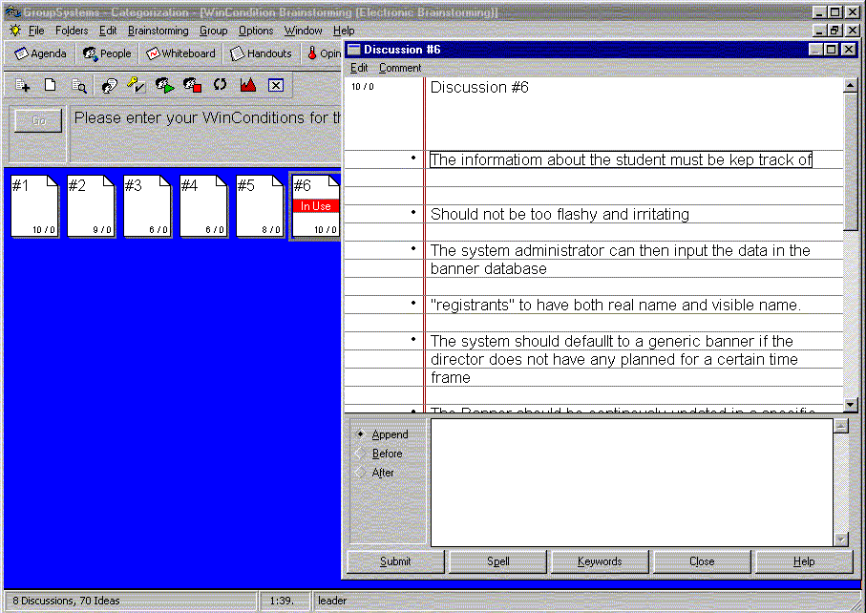


Slide 18
Step 3: Converge on Win Conditions
Objective
  Build and organize win conditions
How
  List and edit win conditions collaboratively (via comments).

Slide 19
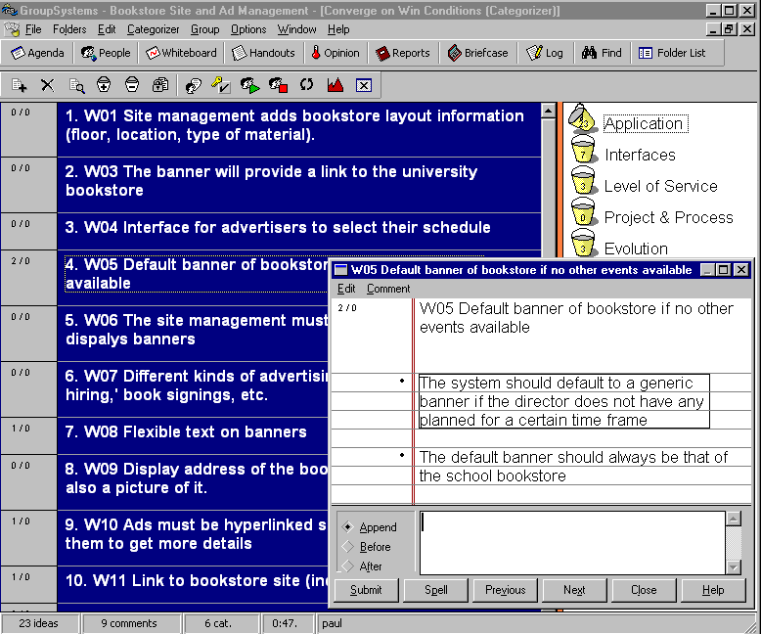

Slide 20
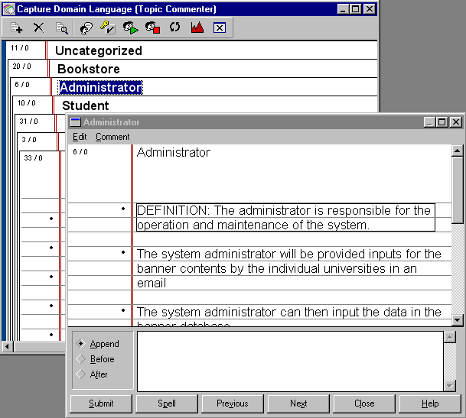
Step 4: Capture a glossary of terms

Slide 21
Step 5: Prioritize win conditions
Objective
  Scope project, gain focus
How
  Vote on Business Importance & Ease of Realization
  Analyze prioritization poll to reveal conflicts, constraints, different perceptions

Slide 22
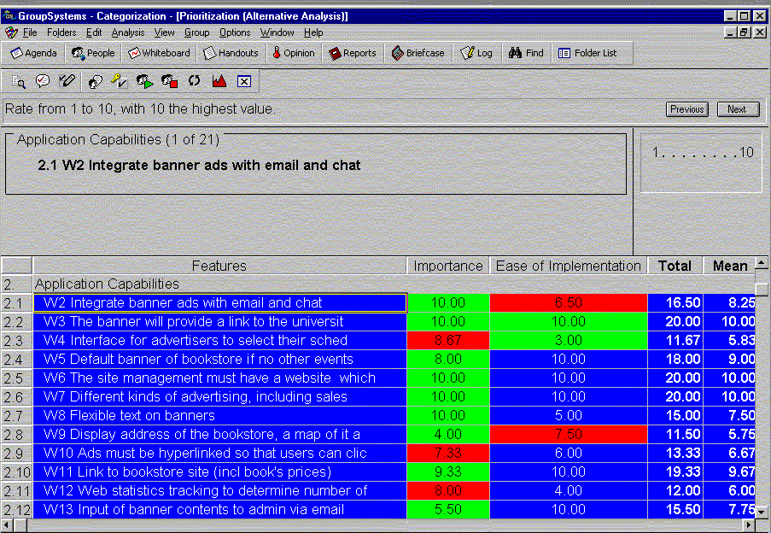
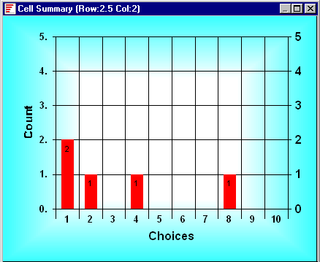
Red cells indicate lack of consensus.

Slide 23
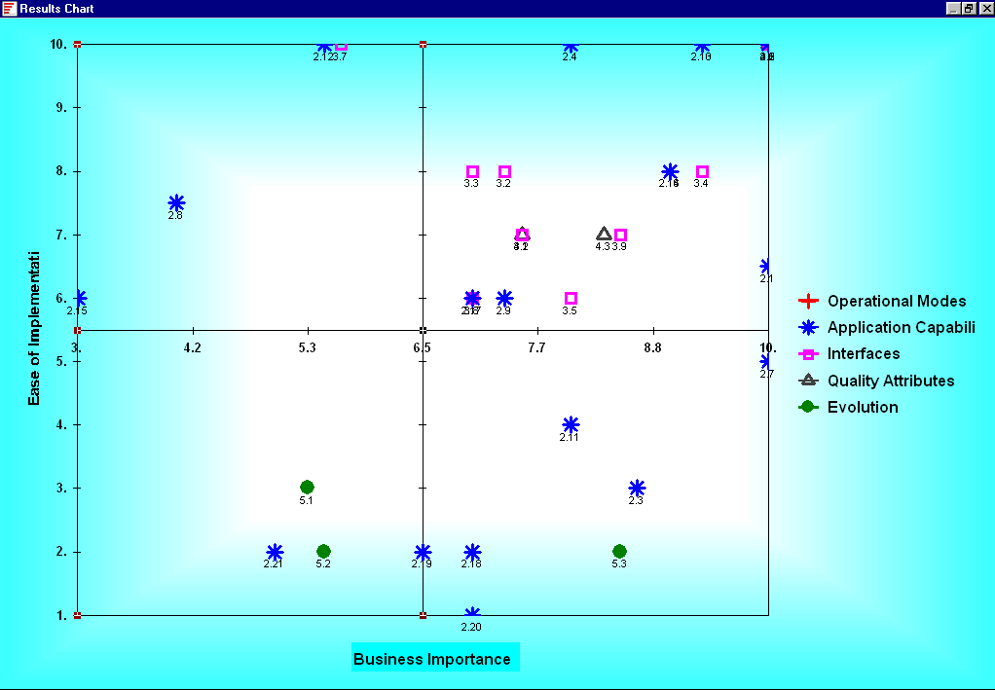
“Low Hanging
Fruits”
“Maybe later”
“Forget
them”
“Important with
hurdles”
After voting,
win conditions are displayed in four categories

Slide 24
Step 6: Build the WinWin Tree
Objective:
  Explore issues and options; negotiate agreements
How:
  Develop/Review pass for issues, options, agreements

Slide 25
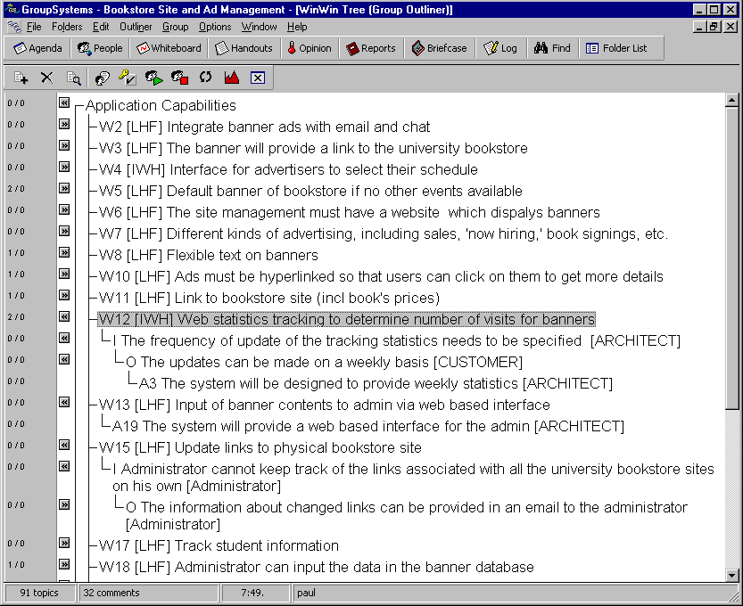
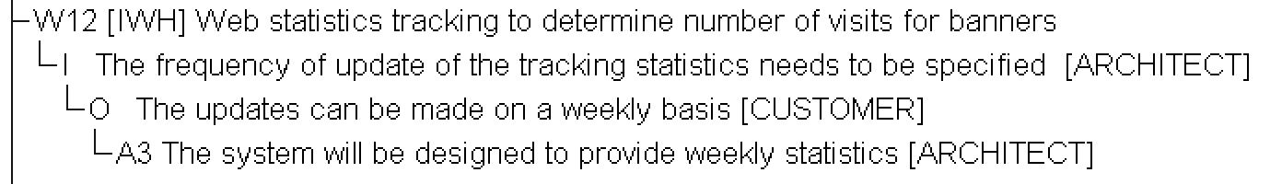

Slide 26
Step 7: Organize negotiation results
Objective:
  Check if negotiation topics have been sufficiently covered
How:
  Categorize/Review requirements into the topics.

Slide 27
Summary
继承了久经考验的IBIS方法的基本思想(Structured Discussion)，又对gIBIS中观察到的问题进行有针对性的改进，从而保证了方法的效果不会太差
明确的结合了Requirements Elicitation这个上下文，从而把通用方法应用到专门领域
不断的改进工具，做了大量Case Study

Slide 28
Synoptic
S. Easterbrook
Handling conflict between domain descriptions with computer-supported negotiation
Knowledge Acquisition 1991

Slide 29
Overview
Aims to compare and synthesize two different descriptions of the same thing in the domain.
Establish correspondences
Exploration Phase
Identify conflict issues between correspondences
Propose resolution options to issues
Generative Phase
Evaluation Phase
Evaluate options
Automation Support
Combine options into a solution

Slide 30
Example: an analyst is trying to establish a state diagram of the books in a library, and is offered two diagrams by two librarians
On Shelf
send to repair
borrow
Librarian A
At Binder
shelve
Out
send to repair
return
On Returned Stack
return
Out of circulation
repair/missing
Available
re-stock
issue
reserve
cancel
reserve
return
Librarian B
reserve
Lent
Reserved
recall
Recalled
issue
reserve

Slide 31
Step 1.1: Establish correspondences (example)
On Shelf
send to repair
Exact
borrow
At Binder
shelve
Out
Partial
send to repair
return
None
return
On Returned Stack
Out of circulation
repair/missing
Available
re-stock
issue
reserve
cancel
reserve
return
reserve
Lent
Reserved
recall
Recalled
issue
reserve

Slide 32









Step 1.1: Establish correspondences (full list)
Out Lent
On Shelf
send to repair
borrow
At Binders Out of Circulation
At Binder
shelve
Out
send to repair
On Shelf, Available, Recalled,
On Returned Stack Reserved
return
On Returned Stack
return
borrow issue
Out of circulation
repair/missing
Available
re-stock
issue
shelve ?
reserve
cancel
reserve
return
reserve
Lent
? reserve, cancel reserve
Reserved
recall
reserve
Recalled
issue
send to repair repair/missing
return (from Out) recall, return
return (from At Binders) re-stock

Slide 33
Step 1.2: Identify issues from correspondences (example)
# | Issue | Source Correspondences
I1 | How to handle missing books in library A? | At Binder – Out of Circulation; repair – repair/missing
I2 | How to borrow books that have been returned/recalled but not shelved in library B? | On Shelf, On Returned Stack – Available, Recalled, Reserved; shelve -- ?
I3 | How to reserve and borrow books in library A? | On Shelf, On Returned Stack – Available, Recalled, Reserved ? – reserve, cancel reserve;
I4 | Does the distinction between “recall” and “return” necessary in library B? | return – recall, return
I5 | We have to distinguish between books returned from readers and repairers. | return (from Out) – return (from At Binders)

Slide 34
Step 2: Propose options to solve the issues (example)
Issue | Options
How to handle missing books in library A? | O1: Replace “At Binders” with “Out of Circulation”.
How to borrow books that have been returned/recalled but not shelved in library B? | O2: Add a “On Returned Stack” state.
How to reserve and borrow books in library A? | O3: Add a “Reserved” state.
Does the distinction between “recall” and “return” necessary in library B? | O4-1: Yes, keep both “Available” and “Recalled” states. O4-2: No, merge the two states.
We have to distinguish between books returned from readers and repairers. | O5: Rename the “return (from At Binders)” to “restock”.

Slide 35
Step 3.1: Evaluate the options
3.1.1: Relate options to issues in terms of the options’ contribution to the issues.
+2: Fully Satisfy +1: Partially Satisfy 0: No effect -1: Partially Frustrates -2: Totally Frustrates
 | Issue 1 | Issue 2 | Issue 3 | Issue 4 | Issue 5
O1: Replace “At Binders” with “Out of Circulation” in A. | +2 | 0 | 0 | 0 | 0
O2: Add a “On Returned Stack” state in B. | 0 | +2 | 0 | 0 | 0
O3: Add a “Reserved” state in A. | 0 | 0 | +2 | 0 | 0
O4-1: Keep both “Available” and “Recalled” in B. | 0 | 0 | 0 | +1 | 0
O4-2: Merge the two states in B. | 0 | +1 | 0 | +1 | 0
O5: Rename the “return (At Binders)” to “restock” in A. | 0 | 0 | 0 | 0 | +2
Issue2: How to borrow books that have been returned/recalled but not shelved in library B?

Slide 36
3.1.2: Relate options to one another
Relations between options
  Incompatible: O4-1 and O4-2
  Compatible: others

Slide 37
Step 3.2: Automatically recommend possible solutions
A solution is composed of compatible options, and it satisfies all issues.
 | Issue 1 | Issue 2 | Issue 3 | Issue 4 | Issue 5
O1: Replace “At Binders” with “Out of Circulation” in A. | +2 | 0 | 0 | 0 | 0
O2: Add a “On Returned Stack” state in B. | 0 | +2 | 0 | 0 | 0
O3: Add a “Reserved” state in A. | 0 | 0 | +2 | 0 | 0
O4-1: Keep both “Available” and “Recalled” in B. | 0 | 0 | 0 | +1 | 0
O4-2: Merge the two states in B. | 0 | +1 | 0 | +1 | 0
O5: Rename the “return (At Binders)” to “restock” in A. | 0 | 0 | 0 | 0 | +2
Solution 1: O1, O2, O3, O4-1, O5;
Solution 2: O1, O2, O3, O4-2, O5

Slide 38
Discussion
Advantages
  首先显式地寻找对应（Correspondence），在从中寻找Issue， 确实有助于识别Issue（大概是比较符合人的思维习惯）
  有了Correspondence及其Issue，在后面提Option的时候，就有了一个上下文（即Correspondence包含的那组对象），有章可循
Disadvantages
  整个方法对人的经验要求很高，因此可能不适合直接让Stakeholder参与协同
    找Correspondence和Issue有一定难度
    Evaluation评分的随意性较强
    不同options对同一Issue的贡献不能简单的累加，因此不同options到底是Compatible还是Incompatible难以判断
  方法运用完成之后还不能立即得到结果，需要后期综合（如上例，选出一组option后，分析人员还需要对比两个图来综合得出最终的图）

Slide 39
OPCI (Organizer & Promoter of Collaborative Ideas)
C. Castro-Herrera, J. Cleland-Huang et al.
Enhancing stakeholder profiles to improve recommendations in online requirements elicitation RE 09
Automated support for managing feature requests in open forums Communications of the ACM 2009

Slide 40
Background
在如今的开源项目平台中（如Sourceforge），开发者主要使用项目论坛与Stakeholders进行交流，其中交流的主题很大一部分是Feature Request，因此论坛成为开源软件进行Requirements Elicitation的主要手段。
在调查了8个开源项目之后（每个项目论坛的发帖数从4000到2,000,000不等），作者发现一个非常突出的问题，即缺乏有效的手段能够把相关的Requirements以及对应的Stakeholders组织到一起进行讨论。这使得同一个/同一类Requirements的讨论散布在许多主题中，开发者不容易将它们整合起来。

Slide 41
The Basic Idea of OPCI
引入文本分析和聚类技术，自动将相关Requirements聚集到同一个论坛版块
引入自动推荐技术，为Stakeholders推荐最相关的版块
作者的工作主要是设计聚类和推荐算法，基本没有提及其他方面（例如Stakeholders在一个版块中怎样协同的讨论/精化需求）

Slide 42
Wiki-RE
B. Decker et al.
Wiki-Based Stakeholder Participation in Requirements Engineering
IEEE Software 2007

Slide 43
Basic Idea
Wiki pages = requirements documents
Predefined page templates
Page analysis
  New pages overview：展示需求获取的进展和潜在的Overlap
  Stub pages overview：未关注或冗余的需求
  Hyperlinks between pages：dependencies
Wiki extensions for document exporting

Slide 44
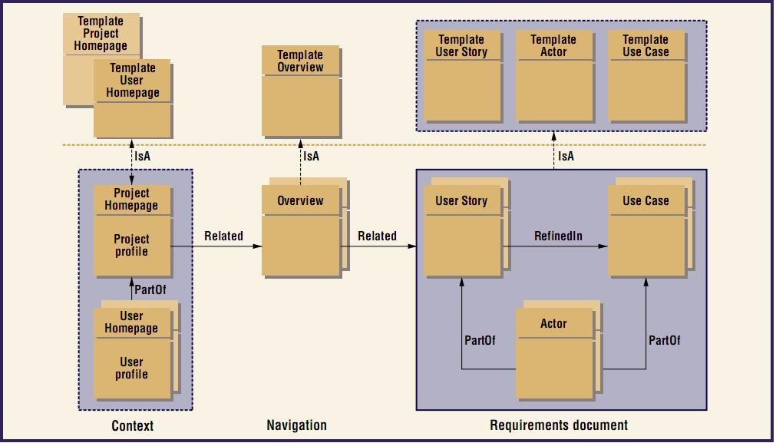

Slide 45
Discussion
Advantages
  Wiki本身是一个成熟且学习成本较低的平台
  Wiki的设计初衷就是为了在线编写文档，因此适合requirements documents.
Disadvantages
  Wiki的协同机制仅仅是普通的讨论区，正如前面OPCI文章所提到的，这种方式在Requirements Elicitation中存在一些问题。也许正因为如此，本文的作者才专注于编写Use Case，这也导致了该方法的适用范围有限。

Slide 46
EGRET
V. Shiha, B. Sengupta, S. Chandra (IBM India & US)
Enabling Collaboration in Distributed Requirements Management
IEEE Software 2006

Slide 47
Introduction
Eclipse-based Requirements Management Tool
在工具中集成了Chat和Email客户端，从而可以将Stakeholder之间的交流内容与Requirements关联起来，并对交流内容进行分析，例如
  发现High-activity Requirements
  计算需求变更的频率
  发现交流中的“瓶颈stakeholders”

Slide 48
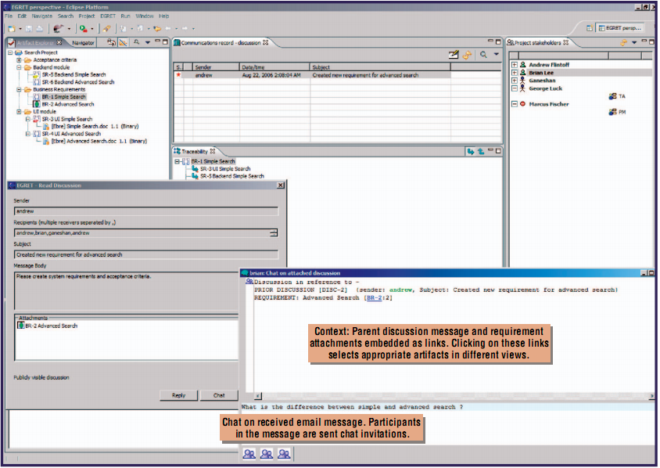

Slide 49
Online Requirements Management Tools
M. Lang, J. Duggan
A Tool to Support Collaborative Software Requirements Management
RE Journal 2001
Contour
http://www.jamasoftware.com/contour

Slide 50
Introduction
REJ 01的这篇文章介绍了一个online RM tool原型，主要特色有：
  支持从本地导入需求文档
  协同编辑需求，类似我们的CRE工具（Author + Comments方式）
在Web 2.0时代，众多公司推出了online RM tool，可以看作是上述原型的强化版，其中比较著名的有Contour http://www.jamasoftware.com/contour/features.php

Slide 51
Discussion
目前看到的online RM Tool跟我们目前的CRE工具相似，侧重点都在如何用网站的方式支持传统需求工程，而协同方式比较简单，以Comment为主
而IBM的Eclipse RM Tool把协同（交流）数据看作是Requirements的上下文，将二者关联起来，感觉是比较有新意的做法

